Slide 1
Precision Time Measurement with accuracy of Sub-nanoseconds
Group:
Gavin Lewis 101617
Aditya Dsouza 101613
Shantanu Shinde 101651

Slide 2
Abstract
The primary application of our project will be at a Time to Digital Converter (TDC) which is an integral component of the Compact Muon Solenoid (CMS) experiment at CERN.
The TDC is component is used to measure the time between the collisions of two elementary particles in the Large Hadron Collider.
This time measurement can be done efficiently by FPGAs as they can handle tasks parallel and produce very less delay in generation of results.
The FPGAs are able to compute the time between two collision pulses with high efficiency

Slide 3
Introduction

Slide 4
Literature Survey
Title | Author(s) | Summary
Time-to-Digital Converter Basics (Chapter from Springer) | Henzler, S. | Analog to Digital Converter and its shortcomings. Basics of Time-to-Digital Converter and the delay line model.
Implementation of a 30 ps Resolution Time to Digital Converter in FPGA | Raguvaran Narasimman, Anil Prabhakar and Nitin Chandrachoodan | Employs “hybrid” approach by combining the Vernier Delay and Tapped Delay Line methods to achieve a 30 ps resolution.
Design and characterization of a low-cost FPGA-based TDC | Tontini, A., Gasparini, L., Pancheri, L. and Passerone | Implementation of the Tapped Delay Line model on a low-cost, low-gate count Xilinx Spartan 6 FPGA.

Slide 5
Literature Survey(Cont.)
Title | Author(s) | Summary
A high-resolution programmable Vernier delay generator based on carry chains in FPGA. | Cui, K., Li, X. and Zhu, R., 2017 | It employs the Vernier Delay method on a Stratix 3 board by Altera to implement TDC achieving a resolution of 38.6 ps with a nominal supply of 1100mV

Slide 6
Existing Systems – Fine Counter
Ramp Interpolator –
When counting is not feasible because the clock rate would be too high, analog methods can be used. Analog methods are often used to measure intervals that are between 10 and 200 ns. These methods often use a capacitor that is charged during the interval being measured.

Slide 7
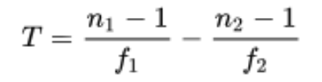
Existing Systems (Contd.)
2. Vernier Interpolator -
The Vernier method is a digital version of the time stretching method. Two only slightly detuned oscillators (with frequencies f 1 and f 2 ) start their signals with the arrival of the start and the stop signal. As soon as the leading edges of the oscillator signals coincide the measurement ends and the number of periods of the oscillators (n 1 and n 2 respectively) lead to the original time interval T:

Slide 8
Existing Systems (Contd..)
3. Tapped Delay Line -
In general a tapped delay line contains a number of cells with well-defined delay times. Propagating through this line the start signal is delayed. The state of the line is sampled at the time of the arrival of the stop signal. This can be realized for example with a line of D-flip-flop cells with a delay time. The start signal propagates through this line of transparent flip-flops and is delayed by a certain number of them. The output of each flip-flop is sampled on the fly. The stop signal latches all flip-flops while propagating through its channel un-delayed and the start signal cannot propagate further. Now the time interval between start and stop signal is proportional to the number of flip-flops that were sampled as transparent.

Slide 9
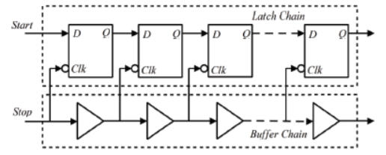

Slide 10
Proposed System
The combination of the fine counter with then pre-existing coarse counter to generate a Hybrid Counter

Slide 11
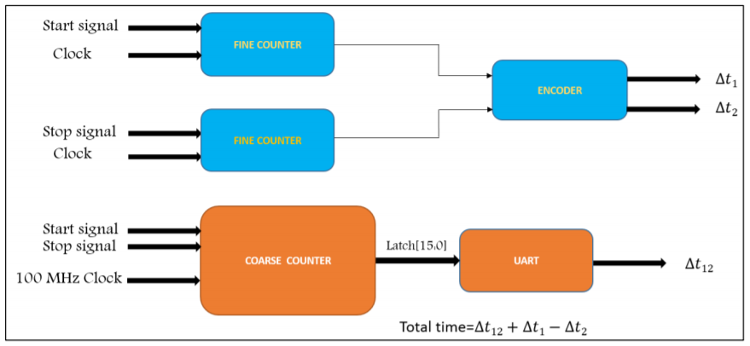
Block Diagram

Slide 12
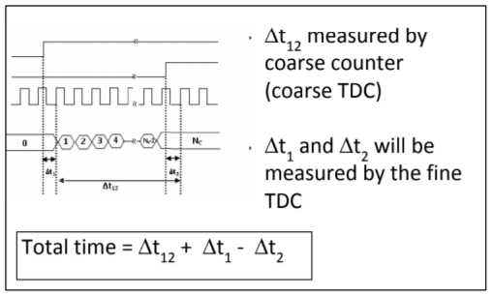

Slide 13
Conclusion
THIS INCLUDES :
1.WORK DONE - ALL THE ACTIVITIES PERFORMED TILL
NOW REGARDING PROJECT
2.WORK TO BE DONE – THE PLANNED ACTIVITIES
REGARDING IMPLEMENTATION

Slide 14
References
Narasimman, R., Prabhakar, A. and Chandrachoodan, N. (2015). Implementation of a 30 ps resolution time to digital converter in FPGA. 2015 International Conference on Electronic Design, Computer Networks & Automated Verification (EDCAV).
Henzler, S. (2010). Time-to-Digital Converters. Springer Series in Advanced Microelectronics.
Tontini, A., Gasparini, L., Pancheri, L. and Passerone, R., 2018. “Design and characterization of a low-cost FPGA-based TDC.” IEEE Transactions on Nuclear Science, 65(2), pp.680-690.
Cui, K., Li, X. and Zhu, R., 2017. “A high-resolution programmable Vernier delay generator based on carry chains in FPGA.” Review of Scientific Instruments, 88(6), p.064703.
http://www.asic-world.com/verilog/veritut.html

